Slide 1


SOC
PlΘtfoím
Complete «nteípíise «®ition
Intelligent Security Operations Monitoring and Incident Response Platform
AeΘm A«C™NOV6
Leader: Meet Jayesh Patel
66+ FEATURES
ENTERPRISE GRADE
Members: Sahil Sharma, Kushal Shukla, Wakar Khan
PRODUCTION READY

Slide 2

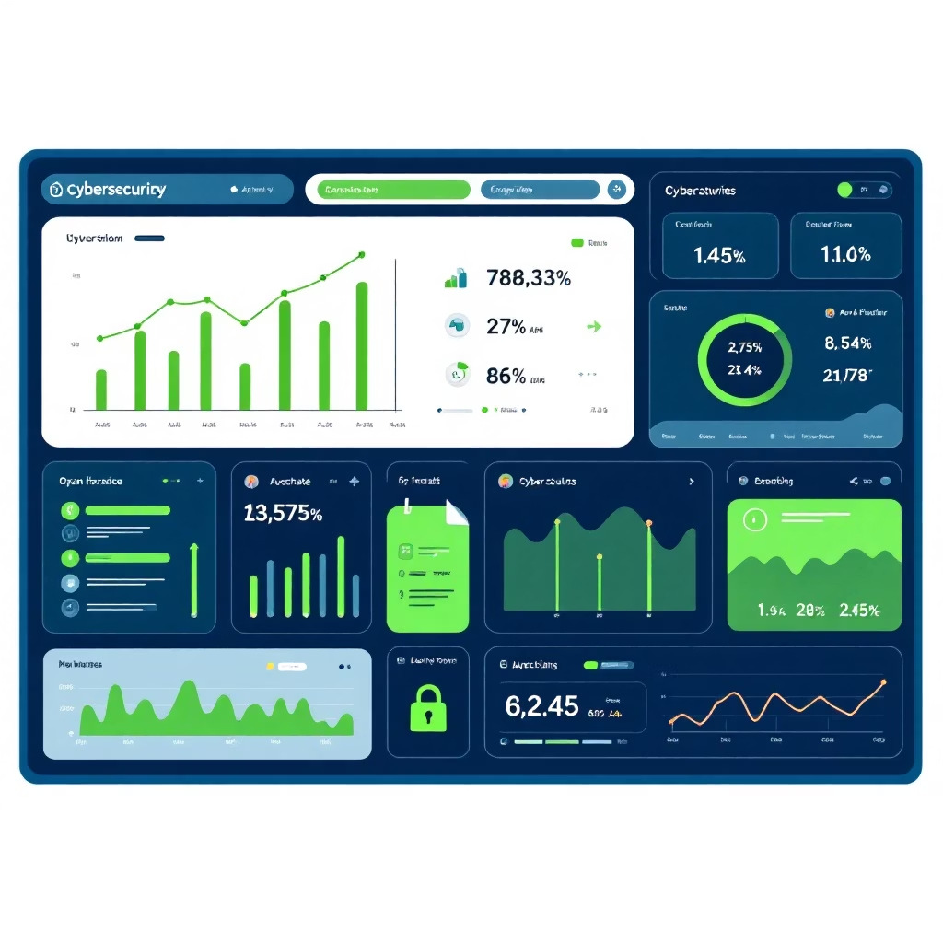
Ahe ChΘllen➆e We Solve
Cuííent ReΘlitK Ouí Solution
6leít OveíloΘ®
Analysts drowning in noise
6I-Poweíe® Ðetestion
Intelligent threat correlation
FíΘ➆mente® ÐΘtΘ
Disconnected log sources
Unifie® PlΘtfoím
Single pane of glass
MΘnuΘl OpeíΘtions
Slow incident response
SO6R 6utomΘtion
Instant incident response

Slide 3





«nteípíise 6íshitestuíe Pipeline
Multi-Souíse Lo➆s
Firewall, IDS, EDR, Cloud
NoímΘlisΘtion «n➆ine
CEF, JSON, Syslog parsing
CoííelΘtion «n➆ine
Event pattern matching
ML Ðetestion
Anomaly identification
SmΘít 6leíts
Prioritised threats
SO6R Response
Automated remediation
MITRE ATT&CK MAPPING
ROLE-BASED ACCESS CONTROL
PLAYBOOK ORCHESTRATION
MULTI-TENANT ARCHITECTURE

Slide 4
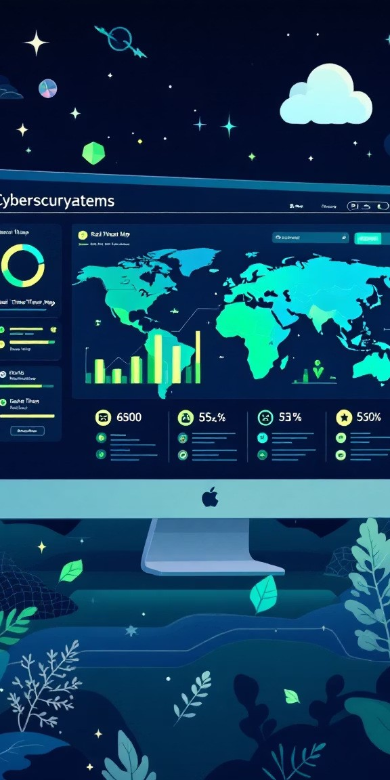



«nteípíise CΘpΘbilities
ReΘl-Aime OpeíΘtions
WebSocket streaming
Mobile push alerts Geo-location mapping Live threat tracking
AhíeΘt Intelli➆ense
VirusTotal integration AbuseIPDB lookup IOC hunting engine Reputation scoring
SesuíitK 6utomΘtion
Cloud-native deployment Compliance reporting Automated backups Incident playbooks

Slide 5




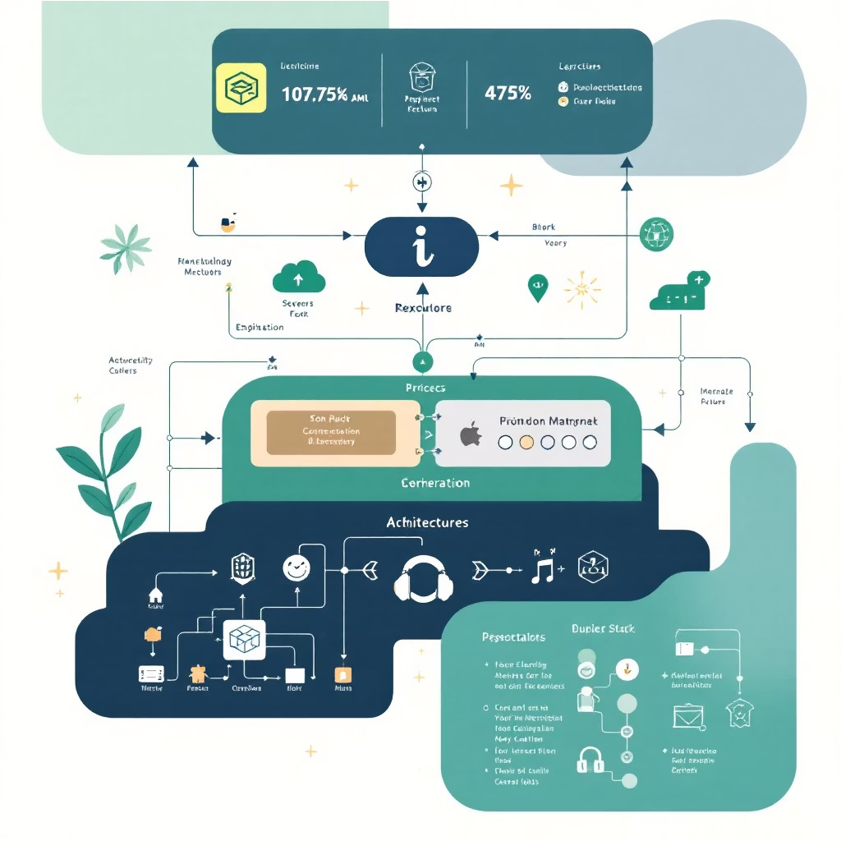
Technical Excellence at Scale
Technology Stack
ÐΘsken®
Python, Flask, Celery
Platfoím Scale
GG
FeΘtuíes
Comprehensive security capabilities
8O=
6PI «n®points
Extensive integration options
Fíonten®
React, WebSocket, Charts
22
Misíoseívises
Scalable architecture design
G=
Ðetestion Rules
Advanced correlation logic
ÐΘtΘ LΘKeí
PostgreSQL, Redis, S3
InfíΘstíustuíe
Docker, K8s, AWS
4
SO6R PlΘKbooks
Automated response workflows
4
UI Ahemes
Customisable dark modes

Slide 6








«xpeíiense the PlΘtfoím
Live Ðemo 6ssess PlΘtfoím «xsellense
^{URL: localhost:5000} 100% HACKATHON COMPLIANCE PRODUCTION READY
Repository: github.com/Codesofsahil/TECKNOVA-HC-102.git
ENTERPRISE GRADE QUICK START READY
Real-Time Monitoíing
“et StΘíte® in Minutes
Clone repository → Configure environment → Deploy containers → Access dashboard
Automated Response
Mobile Aleíts
Thíeat Intelligence Lookup

